Slide 1

Quality Attribute Scenarios
Software Architecture
3rd Year – Semester 1
Lecture 12

Slide 2
Quality Attribute Scenarios (QAS)
A universal and formal way to express Quality Attributes.
The goal of a QAS is to capture unambiguous and testable quality requirements in the same way as use case scenarios do for functional requirements.

Slide 3
General Vs. Concrete Quality Attribute Scenarios
A general scenario is system independent and can, potentially, pertain to any system.
A concrete scenario is specific to the particular system under consideration.
Concrete scenarios are needed to make the quality requirements operational.
A collection of concrete scenarios can be used as the quality attribute requirements for a system.

Slide 4
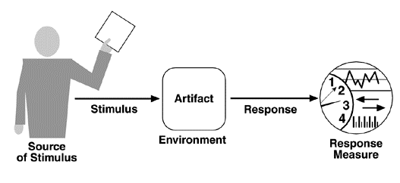
Template for QAS
SOURCE: identifies the originator of the event or action: it can be a user or another system [who]
STIMULUS: describes the action or the external event that arrives at the system [action]
ENVIRONMENT: describes the external circumstances under which the quality requirement needs to be met [when]
ARTIFACT: indicates the part of the system to which the quality requirement applies [what]
RESPONSE: tells us how the system reacts to the stimulus [result]
RESPONSE MEASURE: provides metrics and quantifies the quality attribute [measurement]
Notes:
Source – Who or What makes the change
Stimulus - The change to be / Action
Environment - When the change can be made / Under what conditions / what are the conditions when the stimulus occurs?
Artifact - What is to be changed / The system or a part of it / what elements of the system are stimulated?
Response - How to make it / How the system reacts
Response Measure - Measurement

Slide 5

Availability (QAS)
Concerned with system failure and it’s consequences
Faults and failures
Using the wrong algorithm for computation
Miscalculation / incorrect output
Concerns on failure
Frequency
Results
Non-operative time
Prevention
Notifications
The availability of a system is the probability that it will be operational when it is needed

Slide 6
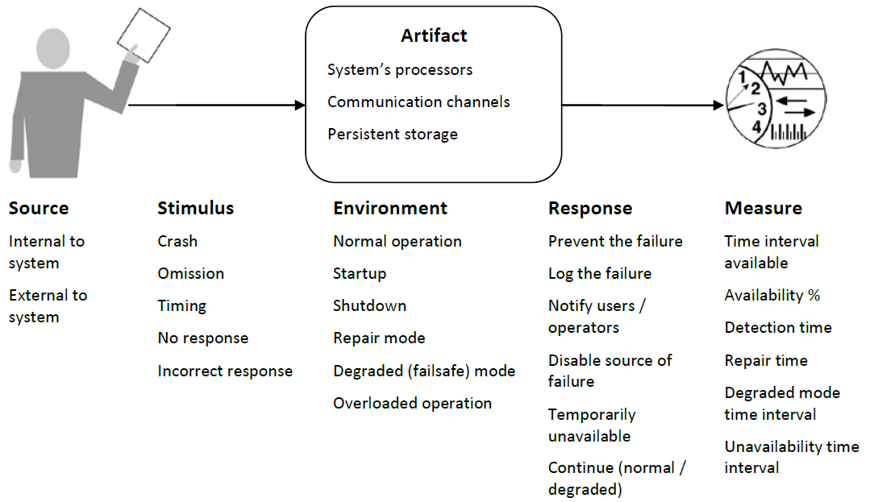
Availability General Scenario

Slide 7
Availability General Scenario
Portion of Scenario | Possible Values
Source | Internal to the system; external to the system
Stimulus | Fault: omission, crash, timing, response
Artifact | System's processors, communication channels, persistent storage, processes
Environment | Normal operation;
 | degraded mode (i.e., fewer features, a fall back solution)
Response | System should detect event and do one or more of the following:
 | record it
 | notify appropriate parties, including the user and other systems
 | disable sources of events that cause fault or failure according to defined rules
 | be unavailable for a prespecified interval, where interval depends on criticality of system
 | continue to operate in normal or degraded mode
Response Measure | Time interval when the system must be available
 | Availability time
 | Time interval in which system can be in degraded mode
 | Repair time

Slide 8
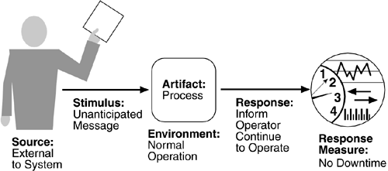
Availability Concrete Scenario
E.g. An unanticipated external message is received by a process during normal operation. The process informs the operator of the receipt of the message and continues to operate with no downtime.
Notes:
Exercise: Write a Concrete Quality Attribute Scenario for Word Application
Kill Signal is received from the Windows OS to Ms. Word Application during process Not Responding state and the application saves unsaved work in a temp file and process terminates without any data loss.

Slide 9
Exercise: Availability Concrete Scenario
Q: Write a Concrete Quality Attribute Scenario for Word Application.
A: Kill Signal is received from the Windows OS to Ms. Word Application during process Not Responding state and the application saves unsaved work in a temp file and process terminates without any data loss.
Identify:
Source
Stimulus
Artifact
Environment
Response
Response Measure

Slide 10
Modifiability (QAS)
Modifiability is about the cost of change.
It brings up two concerns:
What can change (the artifact)?
Functions, Platform, Environnent, Protocol, Qualities, Capacity
When is the change made and who makes it (the environment)?
A developer, an end user, or a system administrator.
At Implementation, Compilation, Build, Configuration, Execution

Slide 11
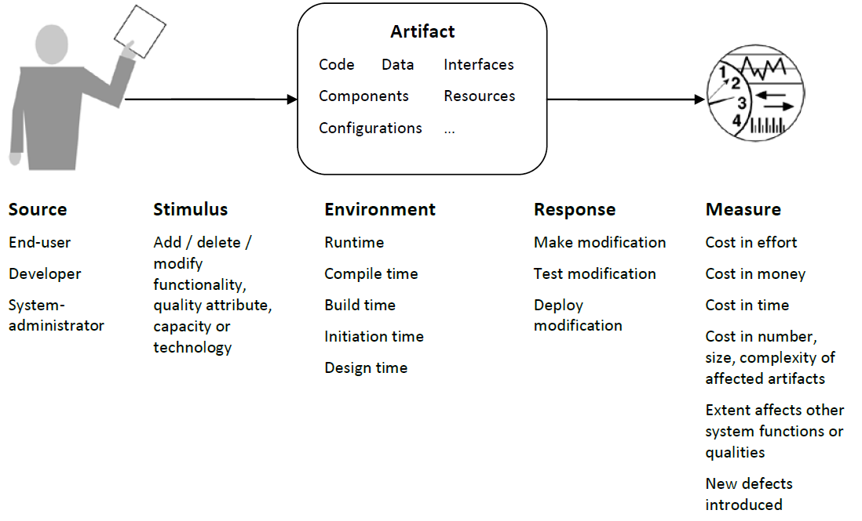
Modifiability General Scenario

Slide 12
Modifiability General Scenario
Portion of Scenario | Possible Values
Source | End user, developer, system administrator
Stimulus | Wishes to add/delete/modify/vary functionality, quality attribute, capacity
Artifact | System user interface, platform, environment; system that interoperates with target system
Environment | At runtime, compile time, build time, design time
Response | Locates places in architecture to be modified; makes modification without affecting other functionality; tests modification; deploys modification
Response Measure | Cost in terms of number of elements affected, effort, money; extent to which this affects other functions or quality attributes

Slide 13
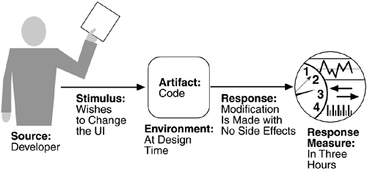
Modifiability Concrete Scenario
E.g. A developer wishes to change the user interface to make a screen's background color blue. This change will be made to the code at design time. It will take less than three hours to make and test the change and no side effect changes will occur in the behavior.
Notes:
Exercise: Write a Concrete Quality Attribute Scenario for updating database Password on a 3 Tier application
System Administrator wishes to change the password of the database configuration file on the Data Tier at the System Maintenance Time; the activity takes 2 minutes and the application is able to connect to the Database without any issues.

Slide 14
Exercise: Modifiability Concrete Scenario
Q: Write a Concrete Quality Attribute Scenario for updating database Password on a 3 Tier application.
A: System Administrator wishes to change the password of the database configuration file on the Data Tier at the System Maintenance Time; the activity takes 2 minutes and the application is able to connect to the Database without any issues.
Identify:
Source
Stimulus
Artifact
Environment
Response
Response Measure

Slide 15
Performance (QAS)
Performance is about timing. Events (interrupts, messages, requests from users, or the passage of time) occur, and the system must respond to them.
There are a variety of characterizations of event arrival and the response but basically performance is concerned with how long it takes the system to respond when an event occurs

Slide 16
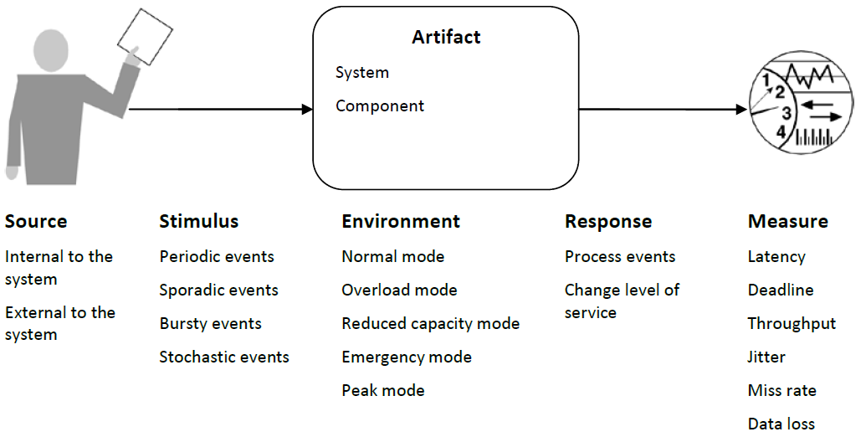
Performance General Scenario
Notes:
Latency – Time to accept request
Deadline – Time between request and response
Jitter – Variation of the time to latency
Throughput – Number of events that can be processed within a particular time interval
Miss rate – Number of events not processed because the system was too busy to respond
Data loss – Data that lost because the system was too busy

Slide 17
Performance General Scenario
Portion of Scenario | Possible Values
Source | One of a number of independent sources, possibly from within system
Stimulus | Periodic events arrive; sporadic events arrive; stochastic events arrive
Artifact | System
Environment | Normal mode; overload mode
Response | Processes stimuli; changes level of service
Response Measure | Latency, deadline, throughput, jitter, miss rate, data loss
Notes:
Latency – Time to accept request
Deadline – Time between request and response
Jitter – Variation of the time to latency
Throughput – Number of events that can be processed within a particular time interval
Miss rate – Number of events not processed because the system was too busy to respond
Data loss – Data that lost because the system was too busy

Slide 18
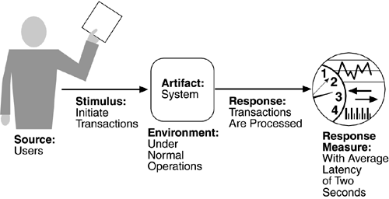
Performance Concrete Scenario
E.g. Users initiate 1,000 transactions per minute randomly under normal operations, and these transactions are processed with an average latency of two seconds.
Notes:
Exercise: Write a Concrete Quality Attribute Scenario for A banking application for a Weekly Transaction Report
The Finance Analyst schedules weekly report of the Banking Application during Normal Operational Time (8am-5pm), the process starts to execute at the Off-Peak Time (between 10pm-2am) and the Report Excel File generates successfully within 30 minutes.
Max Latency = 18 hours (2am – 1am)
Max Deadline = 30 mins

Slide 19
Exercise: Performance Concrete Scenario
Q: Write a Concrete Quality Attribute Scenario for A banking application for a Weekly Transaction Report.
A: The Finance Analyst schedules weekly report of the Banking Application during Normal Operational Time (8am-5pm), the process starts to execute at the Off-Peak Time (between 10pm-2am) and the Report Excel File generates successfully within 30 minutes.
Identify:
Source
Stimulus
Artifact
Environment
Response
Response Measure
Max Latency = 18 hours (8am –> 2am)
Max Deadline = 30 mins

Slide 20
Security (QAS)
Security is a measure of the system's ability to resist unauthorized usage while still providing its services to legitimate users.
An attempt to breach security is called an attack and have many forms;
Unauthorized attempt to access data
Modify data
Intended to deny services to legitimate users.
Characterization
Nonrepudiation : Transaction cannot be denied by any of the parties
Confidentiality : Data or services are protected from unauthorized access.
Integrity : Data or services are being delivered as intended.
Assurance or authenticity : The parties to a transaction are who they purport to be
Availability (no denial of service) : The system will be available for legitimate use
Auditing : The system tracks activities
Notes:
Nonrepudiation is the property that a transaction (access to or modification of data or services) cannot be denied by any of the parties to it. This means you cannot deny that you ordered that item over the Internet if, in fact, you did.
Confidentiality is the property that data or services are protected from unauthorized access. This means that a hacker cannot access your income tax returns on a government computer.
Integrity is the property that data or services are being delivered as intended. This means that your grade has not been changed since your instructor assigned it.
Assurance is the property that the parties to a transaction are who they purport to be. This means that, when a customer sends a credit card number to an Internet merchant, the merchant is who the customer thinks they are.
Availability is the property that the system will be available for legitimate use. This means that a denial-of-service attack won't prevent your ordering this book.
Auditing is the property that the system tracks activities within it at levels sufficient to reconstruct them. This means that, if you transfer money out of one account to another account, in Switzerland, the system will maintain a record of that transfer.
Each of these security categories gives rise to a collection of general scenarios.

Slide 21
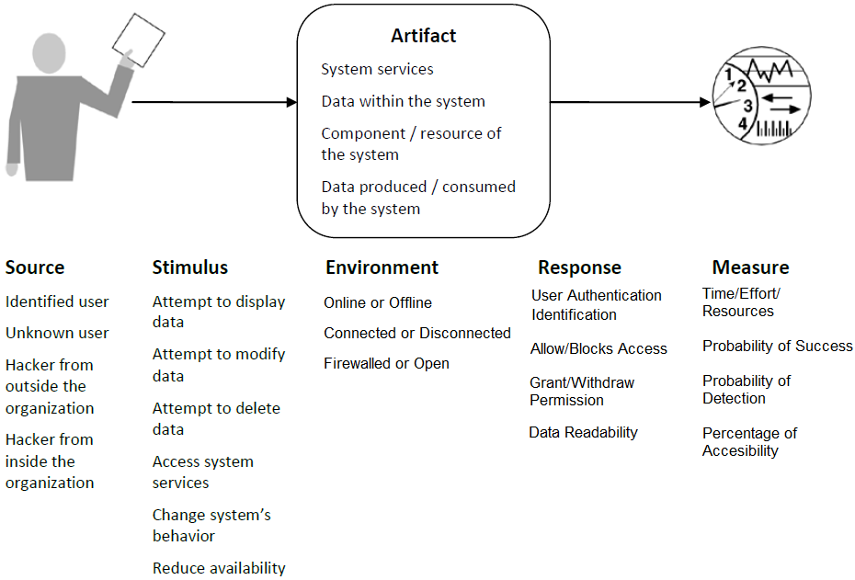
Security General Scenario

Slide 22
Security General Scenario
Portion of Scenario | Possible Values
Source | Individual or system that is correctly identified, identified incorrectly, of unknown identity who is internal/external, authorized/not authorized with access to limited resources, vast resources
Stimulus | Tries to display data, change/delete data, access system services, reduce availability to system services
Artifact | System services; data within system
Environment | Either online or offline, connected or disconnected, firewalled or open
Response | Authenticates user; hides identity of the user; blocks access to data and/or services; allows access to data and/or services; grants or withdraws permission to access data and/or services; records access/modifications or attempts to access/modify data/services by identity; stores data in an unreadable format; recognizes an unexplainable high demand for services, and informs a user or another system, and restricts availability of services
Response Measure | Time/effort/resources required to circumvent security measures with probability of success; probability of detecting attack; probability of identifying individual responsible for attack or access/modification of data and/or services; percentage of services still available under denial-of-services attack; restore data/services; extent to which data/services damaged and/or legitimate access denied

Slide 23
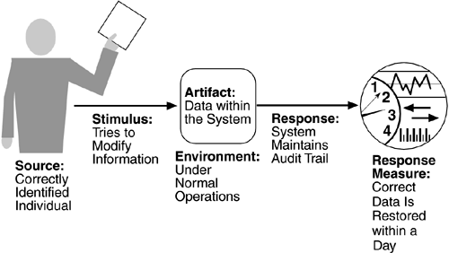
Security Concrete Scenario
E.g. A correctly identified individual tries to modify system data from an external site; system maintains an audit trail and the correct data is restored within one day.
Notes:
Source of stimulus. The source of the attack may be either a human or another system. It may have been previously identified (either correctly or incorrectly) or may be currently unknown.

Slide 24
Testability (QAS)
Software testability refers to the ease with which software can be made to demonstrate its faults through (typically execution-based) testing.
At least 40% of the cost of developing well-engineered systems is taken up by testing.
For a system to be properly testable, it must be possible to control each component's internal state and inputs and then to observe its outputs

Slide 25
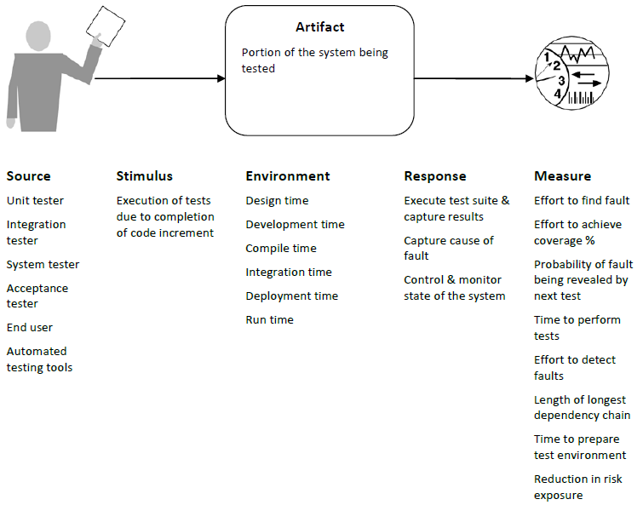
Testability General Scenario

Slide 26
Testability General Scenario
Portion of Scenario | Possible Values
Source | Unit developer; Increment integrator; System verifier; Client acceptance tester; System user
Stimulus | Analysis, architecture, design, class, subsystem integration completed; system delivered
Artifact | Piece of design, piece of code, complete application
Environment | At design time, at development time, at compile time, at deployment time
Response | Provides access to state values; provides computed values; prepares test environment
Response Measure | Percentage of the statements executed; Probability of failure if fault exists; Time to perform tests; Length of longest dependency chain in a test Length of time to prepare test environment

Slide 27
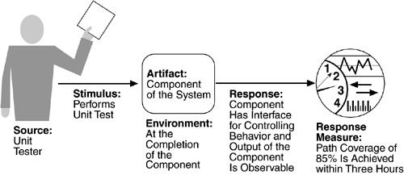
Testability Concrete Scenario
E.g. A unit tester performs a unit test on a completed system component that provides an interface for controlling its behavior and observing its output; 85% path coverage is achieved within three hours.

Slide 28
Usability (QAS)
How easy it is to learn the features of the system
How efficiently the user can use the system
How well the system handles user errors
How well the system adapts to user needs
To what degree the system gives the user confidence in the correctness of its actions.

Slide 29
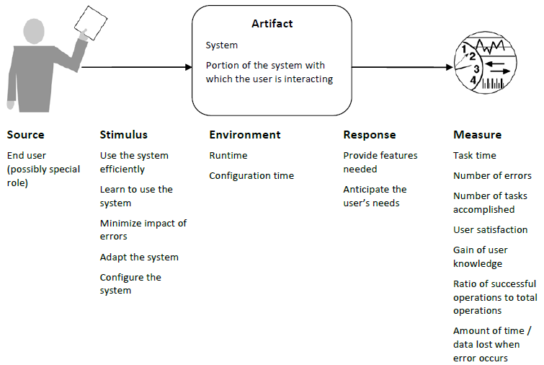
Usability General Scenario

Slide 30
Usability General Scenario
Portion of Scenario | Possible Values
Source | End user is always the source (can be broken down to user roles/actors)
Stimulus | Wants to learn system features; use system efficiently; minimize impact of errors; adapt system; feel comfortable
Artifact | System (or a part of the system the user is interacting)
Environment | At runtime or configure time
Response | System provides one or more of: To support learn system features To support use system efficiently To minimize impact of errors To adapt system: customizability; internationalization To feel comfortable: display system state; work at the user’s pace
Response Measure | Task time, number of errors, number of problems solved, user satisfaction, gain of user knowledge, ratio of successful operations to total operations, amount of time/data lost
Notes:
To support learn system features: help system is sensitive to context; interface is familiar to user; interface is usable in an unfamiliar context
To support use system efficiently: aggregation of data and/or commands; re-use of already entered data and/or commands; support for efficient navigation within a screen; distinct views with consistent operations; comprehensive searching; multiple simultaneous activities
To minimize impact of errors: undo, cancel, recover from system failure, recognize and correct user error, retrieve forgotten password, verify system resources
To adapt system: customizability; internationalization
To feel comfortable: display system state; work at the user’s pace

Slide 31
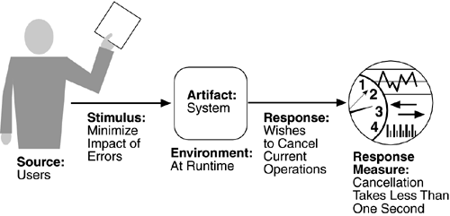
Usability Concrete Scenario
E.g. A user, wanting to minimize the impact of an error, wishes to cancel a system operation at runtime; cancellation takes place in less than one second.

Slide 32
Exercise (offline)
Refer a few existing software systems (e.g. your Group Case Study) and identify 2-3 quality attribute scenarios for the Main Quality Attribute(s) Under consideration
Check with the actual Software System documentation / agreements / guides if the above identified Quality Attribute response measures are stated
Propose new Quality Attribute Scenarios for your system under considerations

Slide 33
Tactics
An architectural tactic is a means of satisfying a quality attribute response measure by manipulating some aspect of a quality attribute model through architectural decisions
NEXT LECTURE:
Ways to improve Quality Attributes
Tactics Framework

Slide 34
References
http://www.ece.ubc.ca/~matei/EECE417/BASS/ch04lev1sec4.html
http://etutorials.org/Programming/Software+architecture+in+practice,+second+edition/Part+Two+Creating+an+Architecture/Chapter+4.+Understanding+Quality+Attributes/4.4+Quality+Attribute+Scenarios+in+Practice/

